Slide 2
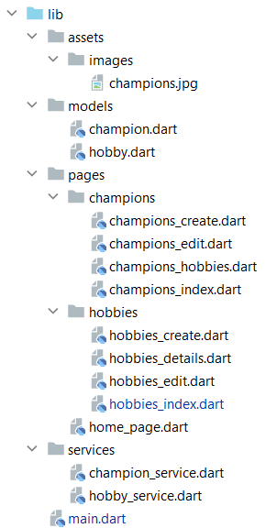
Structuur
uitgangspunten:
De data classen zet je allemaal in een directory met de naam models
Alle api calls maak je in een aparte class in de directory services
De pages structureer je in de directory met de naam pages.

Slide 3
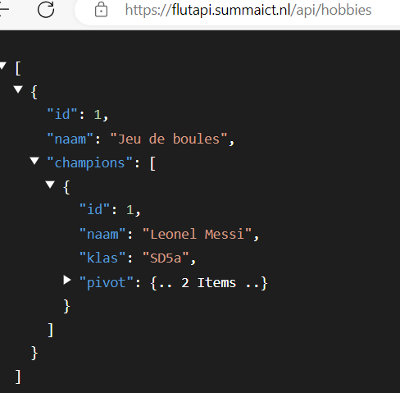
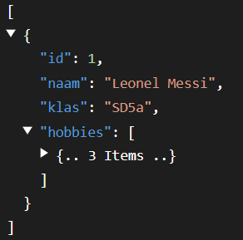
Models
import 'champion.dart'; class Hobby { final int id; final String naam; final List<Champion>? champions; Hobby({ required this.id, required this.naam, this.champions, }); factory Hobby.fromJson(Map<String, dynamic> json) { return Hobby( id: json['id'], naam: json['naam'], ); } }
import 'hobby.dart'; class Champion { final int id; final String naam; final String klas; final List<Hobby>? hobbies; Champion({ required this.id, required this.naam, required this.klas, this.hobbies, }); factory Champion.fromJson(Map<String, dynamic> json) { return Champion( id: json['id'], naam: json['naam'], klas: json['klas'], ); } }

Slide 4
Services: GetAll
Future<List<Champion>> getAll() async { List<Champion> champions = [];
final response = await http.get(Uri.parse('https://flutapi.summaict.nl/api/champions')); if (response.statusCode != 200) { throw Exception( 'Fout bij het ophalen van alle champions (${response.statusCode}).'); } final List<dynamic> data = jsonDecode(response.body); for (int i = 0; i < data.length; i++) { final champion = Champion( id: data[i]['id'], naam: data[i]['naam'], klas: data[i]['klas'], hobbies: []); final List<dynamic> hobbies = data[i]['hobbies']; for (int j = 0; j < hobbies.length; j++) { final hobby = Hobby( id: hobbies[j]['id'], naam: hobbies[j]['naam'], champions: []); champion.hobbies!.add(hobby); } champions.add(champion); } return champions; }
Gebruik:
body: FutureBuilder<List<Champion>>( future: ChampionService().getAll(),

Slide 5
Pages (build)
body: FutureBuilder<List<Champion>>( future: ChampionService().getAll(), builder: (context, snapshot) { if (snapshot.hasError) { return Text(snapshot.error.toString()); } if (!snapshot.hasData) { return const CircularProgressIndicator(); } return _championsIndex(snapshot.data!, context); }, ),
Widget _championsIndex(List<Champion> list, BuildContext context) { return ListView.builder( itemCount: list.length, itemBuilder: (context, index) { return ListTile( leading: _championHobbies(list[index], context), title: Row( children: [ Expanded(child: Text(list[index].naam)), _editChampion(list[index], context), _deleteChampion(list[index].id, context) ], ), subtitle: Text('Aantal hobbies: ${list[index].hobbies?.length ?? 0}'), ); }, ); }

Slide 6
Inloggen beveiligde token
Wat als API beveiligd is met een token
Zorg dat je een token hebt:
In de oefening door in te loggen
Bewaar de token, hier in een static field
Gebruik de token

Slide 7
Authentication Service
import 'dart:convert'; import 'package:http/http.dart' as http; class AuthenticationServices { const String _baseApi = 'http://127.0.0.1:8000/api'; static String _bearerToken = ''; // api/register/ static Future<bool> register (String email, String password, String name) async { … } // api/login/ static Future<bool> login (String email, String password) async { …} // api/logout/ static Future<bool> logout () async { … } }
Bearer Token wordt door de Login service in een static field gezet.
Bearer Token wordt door de Login service in een static field gezet.
Gebruik:
Maak _bearerToken public (underscore ‘_’ weghalen)
Of
Maak een getter / setter voor _bearerToken

Slide 8
Authentication Service - Register
// api/register/ static Future<bool> register (String email, String password, String name) async { final response = await http.post( Uri.parse('$_baseApi/register'), headers: <String, String>{ 'Content-Type': 'application/json; charset=UTF-8', }, body: jsonEncode(<String, String>{ 'name': name, 'email': email, 'password': password, 'password_confirmation' : password }), ); return response.statusCode == 200; }

Slide 9
Authentication Service - Loging
// api/login/ static Future<bool> login (String email, String password) async { final response = await http.post( Uri.parse('$_baseApi/login'), headers: <String, String>{ 'Content-Type': 'application/json; charset=UTF-8', }, body: jsonEncode(<String, String>{ 'email': email, 'password': password }), ); if (response.statusCode == 200) { final result = jsonDecode(response.body); print(response.body); _bearerToken = result['access_token']; } return response.statusCode == 200; }

Slide 10
Authentication Service - Loging
// api/logout/ static Future<bool> logout () async { final response = await http.post( Uri.parse('$_baseApi/logout'), headers: <String, String>{ 'Content-Type': 'application/json; charset=UTF-8', 'Authorization' : 'Bearer $_bearerToken' }, ); return response.statusCode == 200; }

